Slide 1
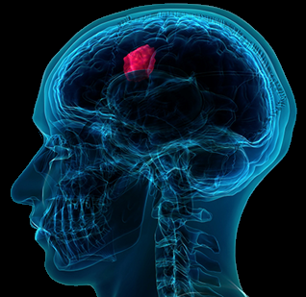
3D U-NET: FULLY CONVOLUTIONAL NEURAL NETWORK FOR
AUTOMATIC BRAIN TUMOR DETECTION
AND SEGMENTATION

Slide 2
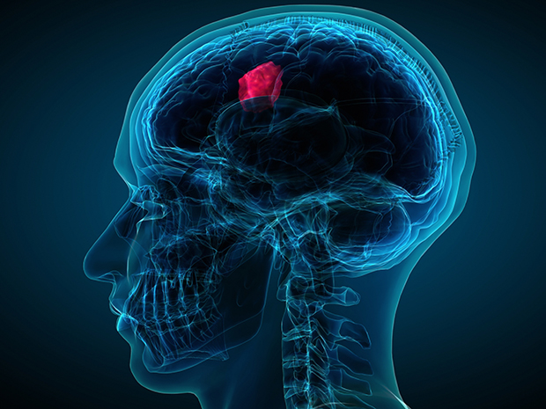
PRESENTED BY
Syed Fahim Ahmed 15.01.04.051
Tasmia Tabassum Arony 15.01.04.079
Md. Tariqul Islam Bhuiyan 15.01.04.081
Fairuz Shezuti Rahman 15.01.04.098
SUPERVISED BY
Emam Hossain
Assistant Professor Department of CSE Ahsanullah University Of Science & Technology

Slide 3
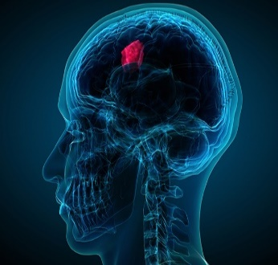
Overview
Introduction
Conclusion
Future Plan
Result & Discussion
Methodology
Literature Review

Slide 4

Introduction
Brain tumor, one of the most vulnerable diseases of the world
2 types of tumor depending on threat level
Using MRI images for tumor detection
Differentiate normal vs. tumor affected brain
Applying CNN for classification of HGG & LGG
Used 3D U-Net for tumor segmentation
Localization of tumor area

Slide 5

Motivation
Increasing number of patients
Time consumption in case of tumor detection
Development of tumor diagnosis
Increment of computer aided researches
Lot to improve in field of accurate classification

Slide 6

Literature Review
27 November,2018

Slide 7
Literature Review
Convolutional Neural Network (CNN) Based Approach
U-net Based Approach
Different Neural Network Based Methods
Clustering Techniques
Machine Learning Algorithms Based Approach
Digital Image Processing Based Methods
4

Slide 8
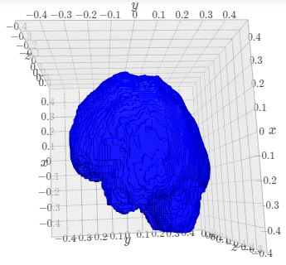
Used Dataset
Brats 2015
Data of HGG and LGG Patients
Data of Normal Brain
4 types of data: Flair, t1, t1c, t2
Figure-1: 3D View of Brain

Slide 9
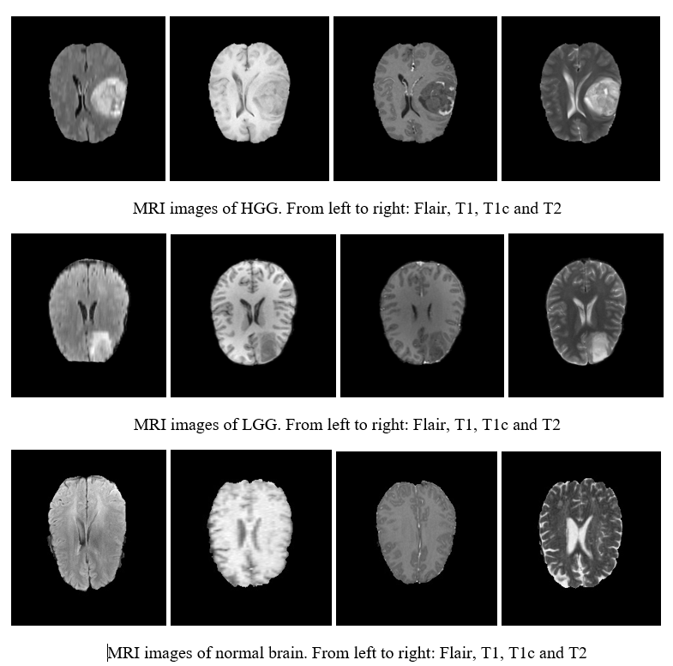
Used Dataset (cont.)
6
Figure-2: Dataset of BRATS 2015

Slide 10

Methodology

Slide 11
Methodology
1. Tumor Detection
Figure-3:Flowchart of Tumor Detection
Input MRI Image
Standardization
Data Augmentation
CNN Based Architecture
Decision

Slide 12
Methodology (cont.)
1.Tumor Detection
1.1 Pre-processing
1.1.1 Feature Scaling
1.1.2 Image Augmentation

Slide 13
Methodology (cont.)
1. Tumor Detection
1.2 Covolutional Neural Network
An advanced and feed-forward Ann to analyze visual image
Developed image classification algorithm
Self-taught Neural filtered algorithm
Convolutional layer to get feature map

Slide 14
Methodology (cont.)
1. Tumor Detection
1.2 Convolutional Neural Network
1.2.1 Convolutional Layer
1.2.2 Activation Function
1.2.3 Pooling Layer
1.2.4 Flattening
1.2.5 Full Connection
1.2.6 Softmax Function
1.2.7 Cross-Entropy

Slide 15
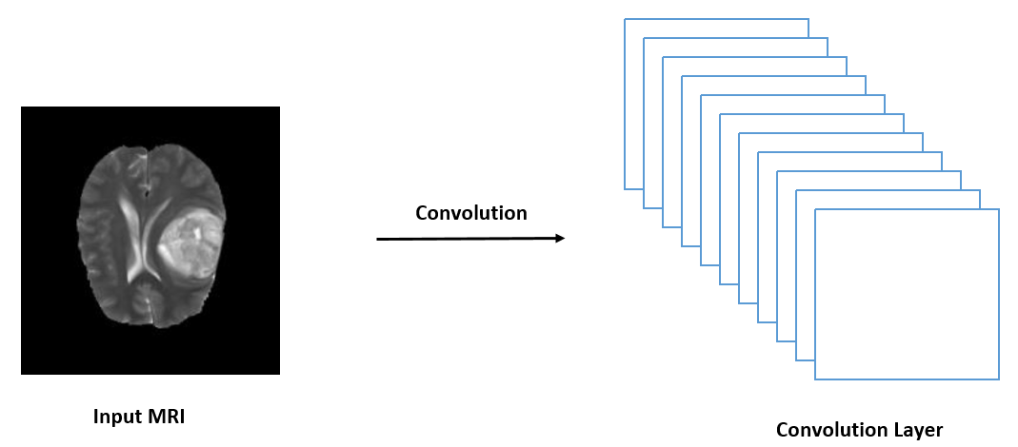
Methodology (cont.)
Methodology (cont.)
1.Pre-processing
1.Pre-processing
1. Tumor Detection
1.2 Convolutional Neural Network
Figure-4: Convolutional layer from input MRI
15
11

Slide 16
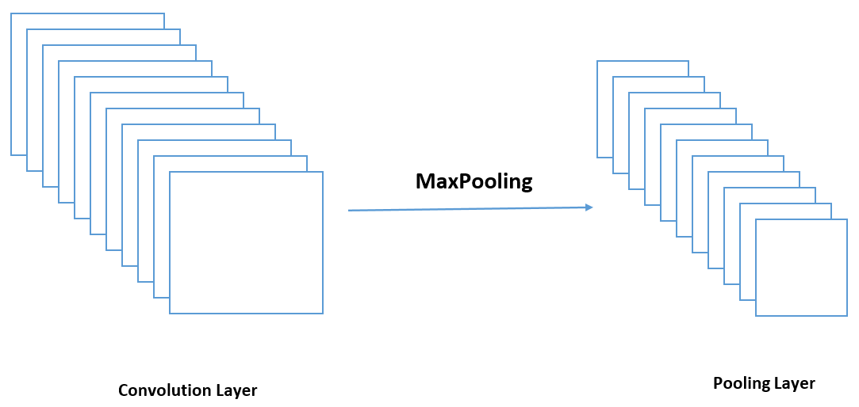
Methodology (cont.)
Methodology (cont.)
1.Pre-processing
1.Pre-processing
1. Tumor Detection
1.2 Convolutional Neural Network
Figure-5: Max pooling from convolutional layer
16
12

Slide 17
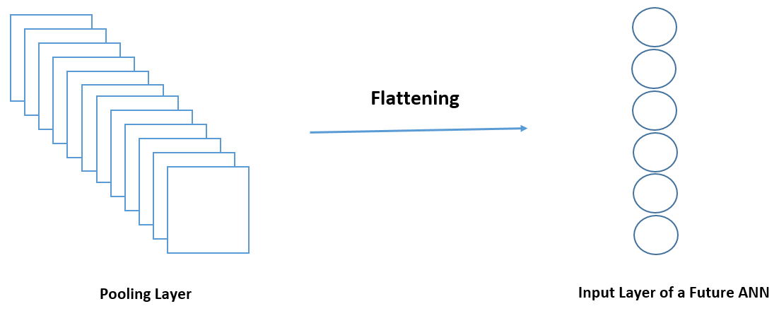
Methodology (cont.)
Methodology (cont.)
1.Pre-processing
1.Pre-processing
1. Tumor Detection
1.2 Convolutional Neural Network
Figure-6: Flattening from pooling layer
17
13

Slide 18
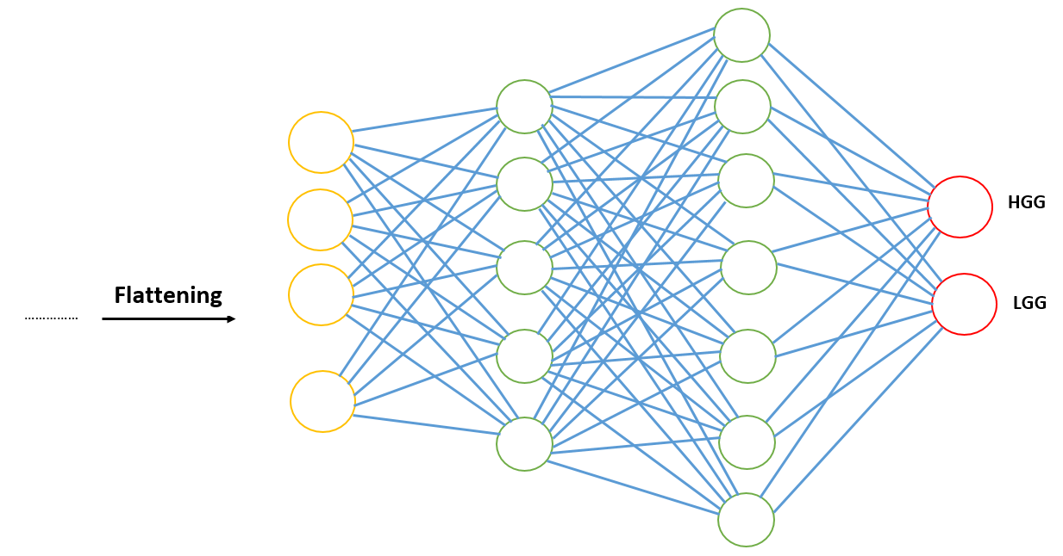
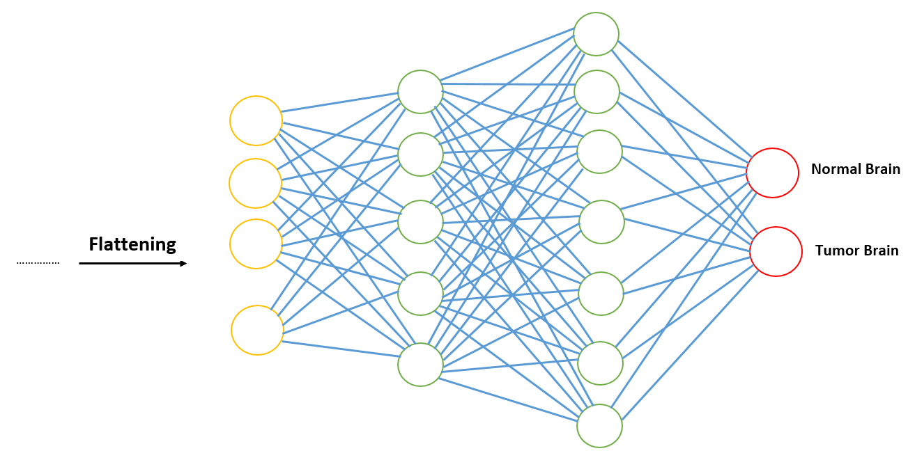
Methodology (cont.)
Methodology (cont.)
1.Pre-processing
1.Pre-processing
1. Tumor Detection
1.2 Convolutional Neural Network
Figure-7: Full Connection
18
14

Slide 19
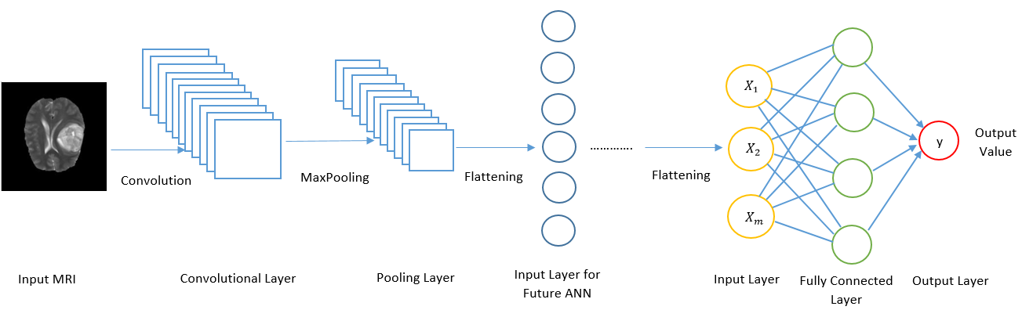
Methodology (cont.)
1. Tumor Detection
1.2 Covolutional Neural Network
Figure-8: Convolutional Neural Network

Slide 20
Methodology (cont.)
 | Type | Filter Size | Stride | filters | FC units | Input
Layer 1 | Convolutional Layer | 3x3 | 1x1 | 32 | - | 3x64x64
Layer 2 | Convolutional Layer | 3x3 | 1x1 | 32 | - | 32x62x62
Layer 3 | Convolutional Layer | 3x3 | 1x1 | 32 | - | 32x60x60
Layer 4 | Max-pooling | 2x2 | 2x2 | - | - | 32x58x58
Layer 5 | Convolutional Layer | 3x3 | 1x1 | 64 | - | 32x29x29
Layer 6 | Convolutional Layer | 3x3 | 1x1 | 64 | - | 64x27x27
Layer 7 | Convolutional Layer | 3x3 | 1x1 | 64 | - | 64x25x25
Layer 8 | Max-pooling | 2x2 | 2x2 | - | - | 64x23x23
Layer 9 | Full Connection | - | - | - | 128 | 7744
Layer 10 | Full Connection | - | - | - | 128 | 128
Layer 11 | Full Connection | - | - | - | 1 | 128
Table-1: Architecture of CNN for Tumor Detection

Slide 21
Methodology(cont.)
2. Tumor Segmentation
Input MRI Image
Standardization
Data Augmentation
3D U-net
Segmentation
Image Re-sizing
Figure-9:Flowchart of Tumor Segmentation

Slide 22
Methodology (cont.)
2.Tumor Segmentation
2.1 Pre-processing
2.1.1 Image Re-sizing
2.1.2 Image Augmentation

Slide 23
Methodology (cont.)
2.Tumor Segmentation
2.1 Pre-processing
2.1.1 Image Re-sizing
Makes model more efficient in terms of time consumption
Original size image of 240×240×155 converted into 32×32×32
Data reduced from 2.87GB instead of 782GB

Slide 24
Methodology (cont.)
2. Tumor Segmentation
2.1 Pre-processing
2.1.2 Image augmentation
Methods | Range
Flip horizontally | 50% probability
Flip vertically | 50% probability
Rotation | ±20°
Shift | 10% on both horizontal and vertical direction
Shear | 20% on horizontal direction
Zoom | ±10%
Brightness | γ = 0.8 ~ 1.2
Table-2: Applied Data Augmentation Methods

Slide 25
Methodology (cont.)
2. Tumor Segmentation
2.2 Semantic Segmentation
Partitioning image into different regions
Grouping each pixel of the image based on specific characteristics
Level every pixel of a picture with a corresponding class
Maintains encoder/decoder structure

Slide 26
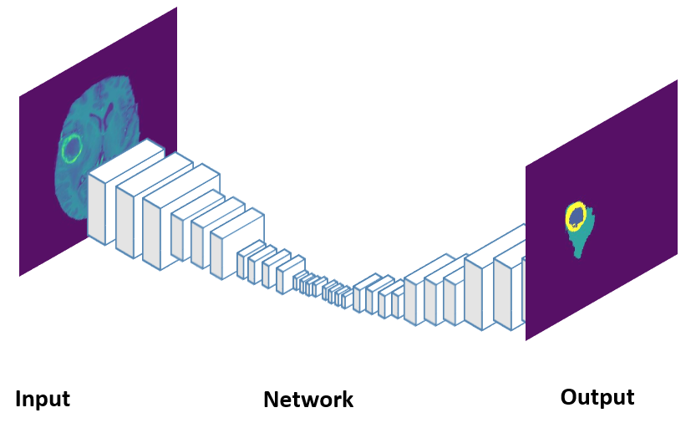
Methodology (cont.)
2. Tumor Segmentation
2.2 Semantic Segmentation
Figure-10: Semantic Segmentation

Slide 27
Methodology (cont.)
2. Tumor Segmentation
2.2 3D U-net
An architecture of Semantic Segmentation which combines encoding and decoding
Two path architecture
First path- Construction path which is encoder part
Second path- Symmetric expanding path which is decoder part

Slide 28
Methodology (cont.)
2. Tumor Segmentation
2.2 3D U-net
2.2.1 Convolution Operation
2.2.2 Max Pooling Operation
2.2.3 Up-sampling Operation
2.2.4 Transposed Convolution Operation
2.2.5 Activation Function

Slide 29
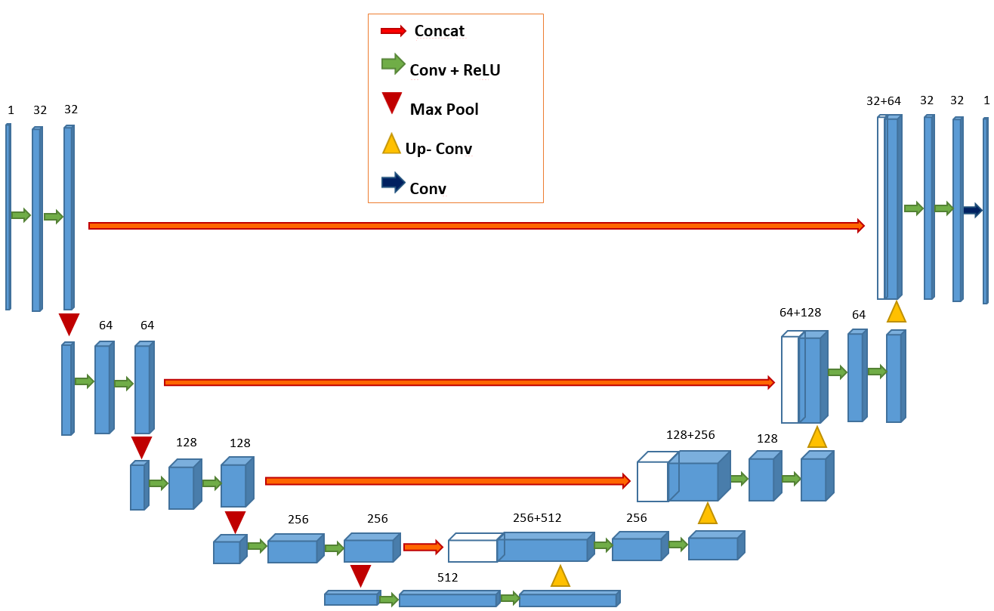
Methodology(cont.)
Figure-11: U-net Architecture of Our Model

Slide 30
Methodology(cont.)
Parameters | Value
Number of convolutional blocks | [4, 5, 6]
Number of deconvolutional blocks | [4, 5, 6]
Table-3: U-net Architecture of Our Model

Slide 31

Result & Discussion

Slide 32
Result & Discussion
1. Tumor Detection
1.1 Normal Brain Image vs. Tumor Brain Image
Data Type | Accuracy | Loss Function
Training Data | 84.07% | 38.89%
Validation Testing | 74.30% | 47.79%
Table-4: Accuracy & Loss Function value for Normal vs. Tumor affected

Slide 33
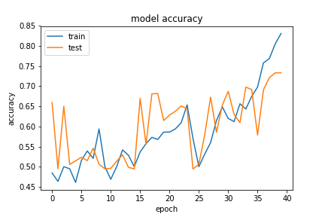
Result & Discussion
1. Tumor Detection
1.1.1 Accuracy of Normal vs. Tumor affected
Figure-12: Accuracy Graph for Normal vs. Tumor affected
28

Slide 34
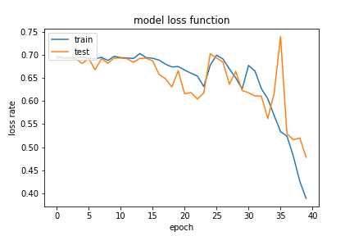
Result & Discussion
1. Tumor Detection
1.1.2 Loss function of normal vs. tumor affected
Table-13: Accuracy & Loss Function value for Normal vs. Tumor affected
34
29

Slide 35
Result & Discussion
1. Tumor Detection
1.2 High Grade Gliomas vs. Low Grade Gliomas
Data Type | Accuracy | Loss Function
Training | 78.12% | 47.04%
Validation Testing | 69.25% | 69.32%
Table-5: Accuracy & Loss Function value for HGG vs. LGG
30

Slide 36
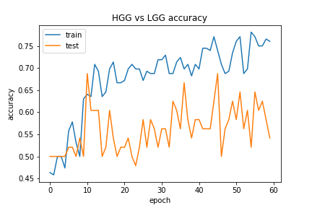
Result & Discussion
1. Tumor Detection
1.2.1. Accuracy of HGG vs. LGG
Figure-14: Accuracy Graph for HGG vs. LGG
36
36
31

Slide 37
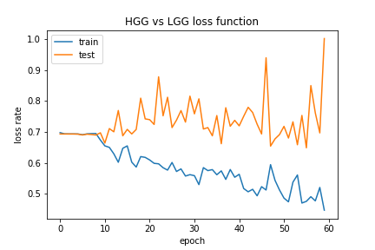
Result & Discussion
1. Tumor Detection
1.2.2 Loss Function of HGG vs. LGG
Figure-15: Loss Function Graph for HGG vs. LGG
32
37
37

Slide 38
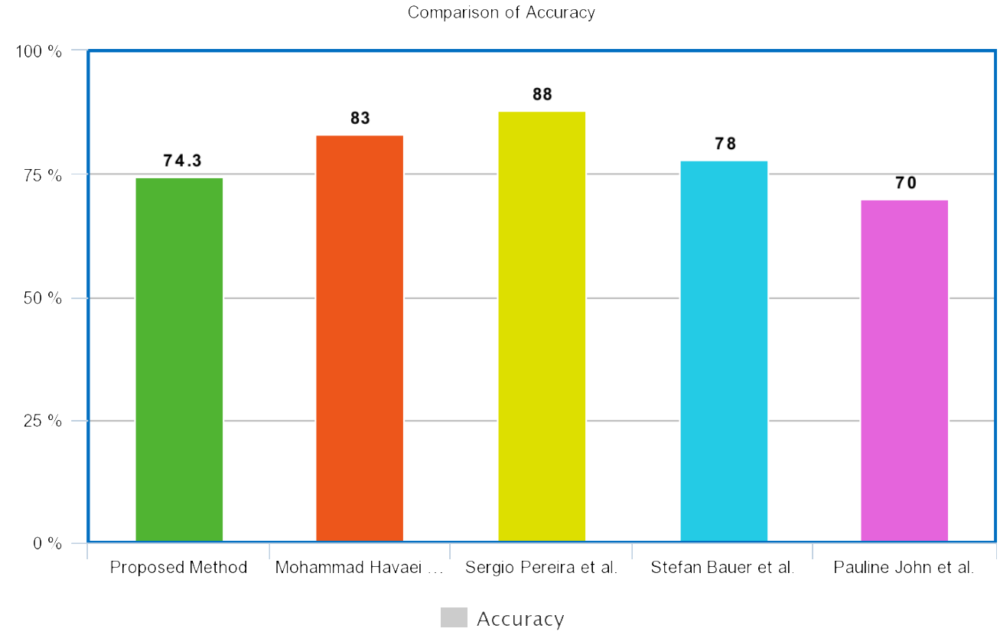
Result & Discussion
1. Tumor Detection
1.3.1 Comparison of Accuracy
Figure-16: Comparison chart of accuracy
33

Slide 39
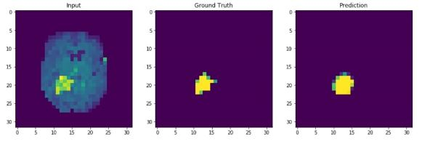
Result & Discussion
2. Tumor Segmentation
2.1 Segmentation Result for BRATS 2015
Figure-17: Segmentation for T1 MRI
34
39
39

Slide 40
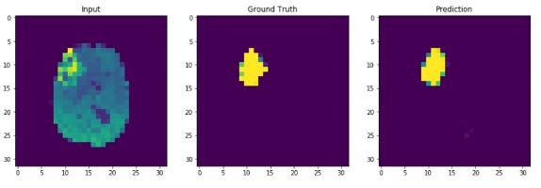
Result & Discussion
2. Tumor Segmentation
2.1 Segmentation Result for BRATS 2015
Figure-18: Segmentation for T1c MRI
35
40
40

Slide 41
Result & Discussion
2. Tumor Segmentation
2.2 Performance of the Model
Data Type | Accuracy | Loss Function
Training Data | 93.08% | 21%
Validation Testing | 92.09% | 19%
Table-6: Accuracy & Loss Function value for Tumor Segmentation

Slide 42
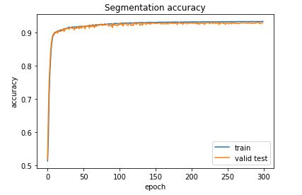
Result & Discussion
2. Tumor Segmentation
2.2.1 Accuracy of Tumor Segmentation
Figure-19: Accuracy Graph for Tumor Segmentation

Slide 43
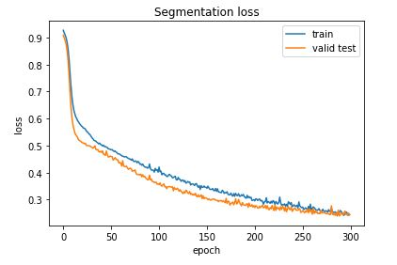
Result & Discussion
2. Tumor Segmentation
2.2.1 Loss Function of Tumor Segmentation
Figure-20:Loss Function Graph for Tumor Segmentation

Slide 44
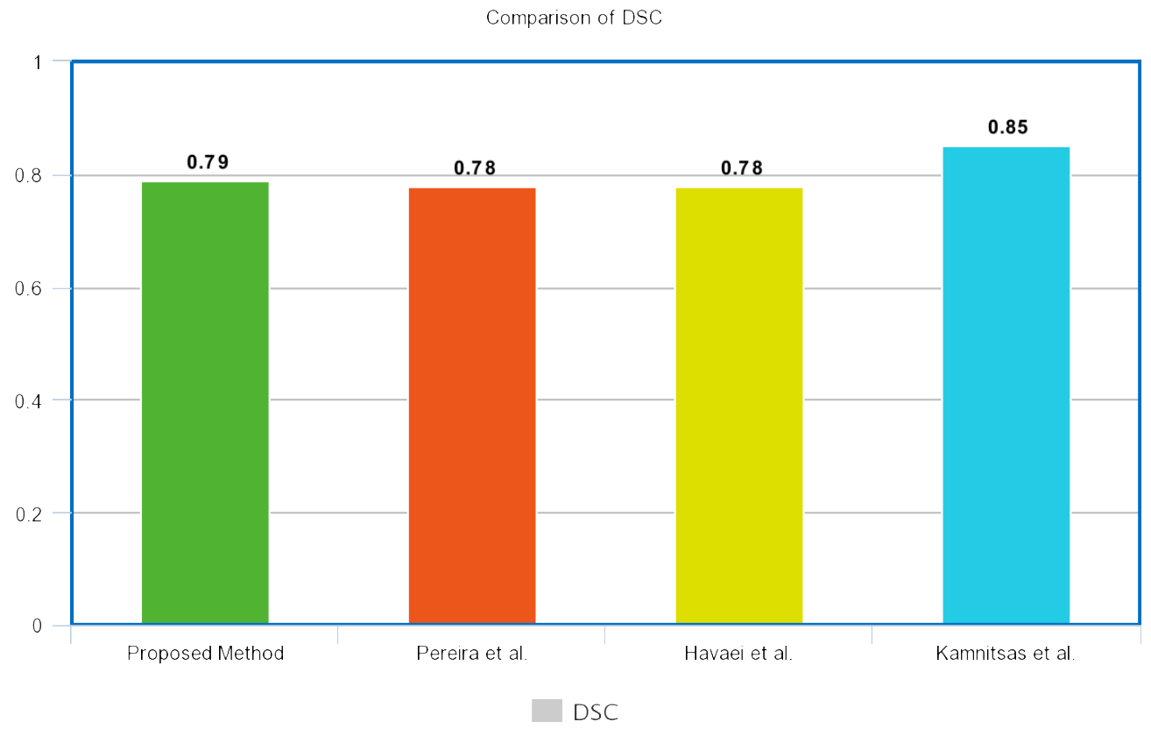
Result & Discussion
2. Tumor Segmentation
2.3.1 Comparison of DSC
Figure-21: Comparison of methods in respect of DSC
39
44
44

Slide 45
Result & Discussion
2. Tumor Segmentation
2.3.2 Comparison of Efficiency
Method | Data | Time
Proposed Method | BRATS 2015 | Less than 1sec
Hao Dong et al. | BRATS 2015 | 2 ~ 3sec
Sergio Pereira et al. | BRATS 2015 | 8min
Mohammad Havaei et al. | BRATS 2015 | 25sec ~ 3min
Table-7: Comparison of methods in respect of DSC
40
45
45

Slide 46
Future Work
Limitations
Separate independent testing dataset required
L1, L2 or dropout regularization not applied in segmentation
Lack of effective image distortion technique
Insufficient GPU
Less images for training

Slide 47
Future Work (Cont.)
Possible Future Approaches
Tuning the hyperparameters of our FCN
Adding more hidden layers
Using separate independent testing dataset
Using different regularizations
Applying elastic image distortion
Evaluating results on higher GPU
More images for training

Slide 48
Conclusion
Segment the MRI images
Abnormal and normal brain classification
High-grade gliomas and low-grade gliomas differentiation
Barred down the training time
Decremented computation time
Surgical planning and patient welfare

Slide 49


Slide 50


